Slide 1

Text Mining and Natural Language Processing 2023-2024 SelectWise
Ghiotto Alessandro 513944
alessandro.ghiotto01@universitadipavia.it

Slide 2
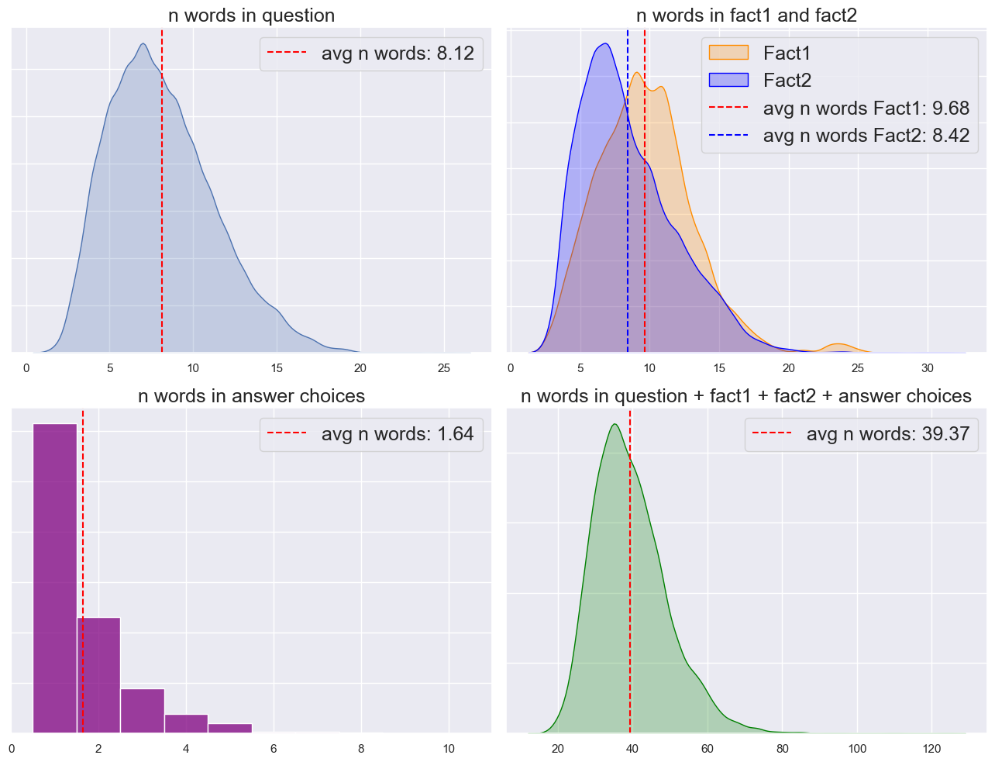
QASC dataset
question: "Climate is generally described in terms of what?
fact1: "Climate is generally described in terms of temperature and moisture."
fact2: "Fire behavior is driven by local weather conditions such as winds, temperature and moisture."
8 choices: {A:"sand",…, H:"city life"]}
label: "F“
 | Number of samples
Train | 7323
Val | 811
Test | 926

Slide 3
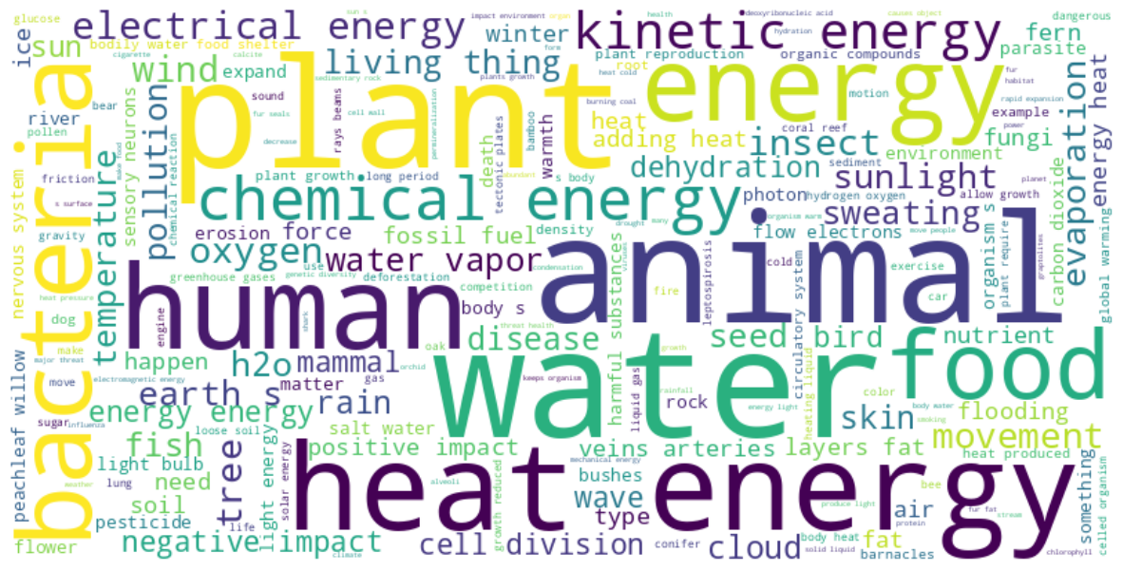
Theme: grade school science

Slide 4
1. Count based methods

Slide 5
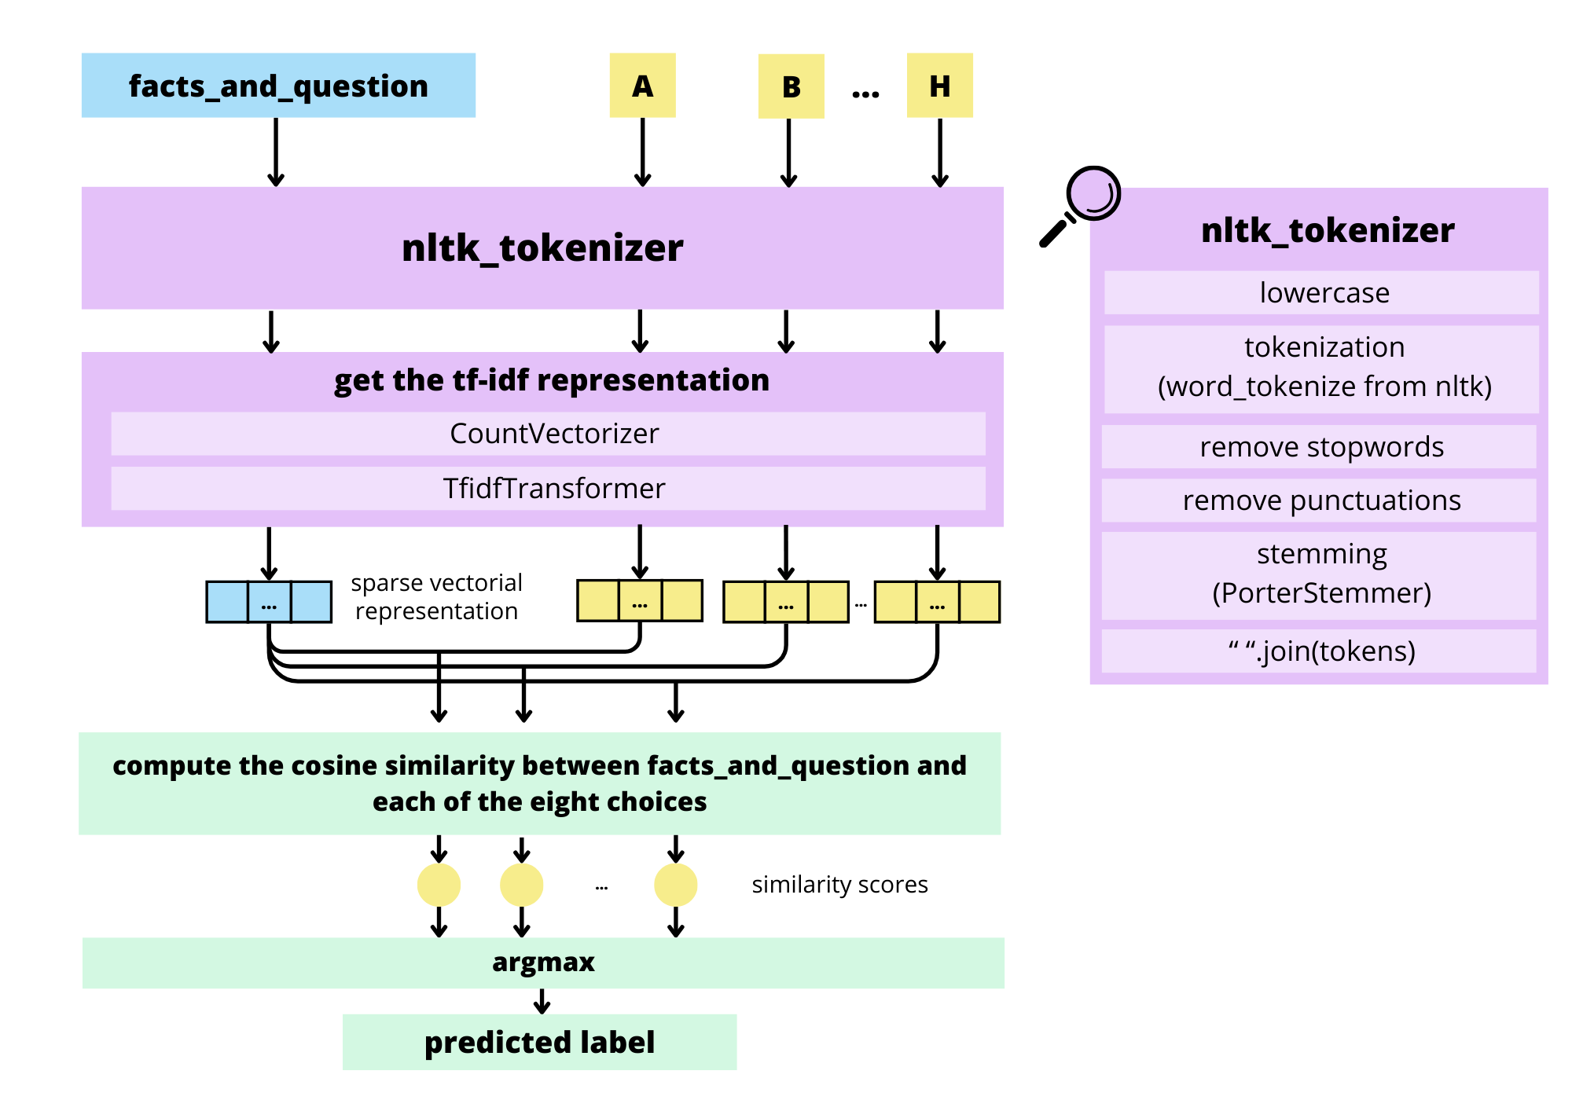
TF-IDF weighting
In the tf-idf representation, which is the choice that is most similar to the question?

Slide 6
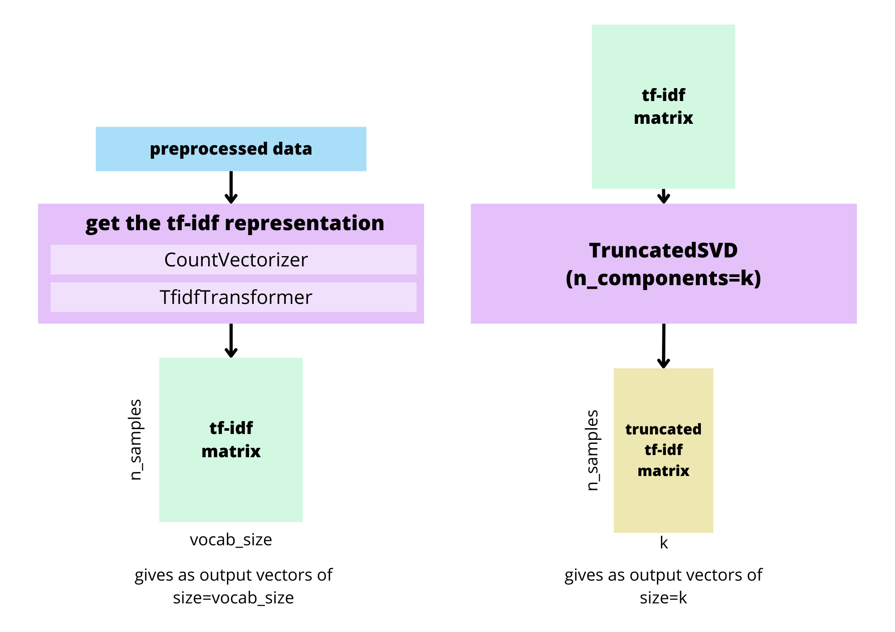
We can truncate the tf-idf matrix with SVD to get a dense representation.

Slide 7
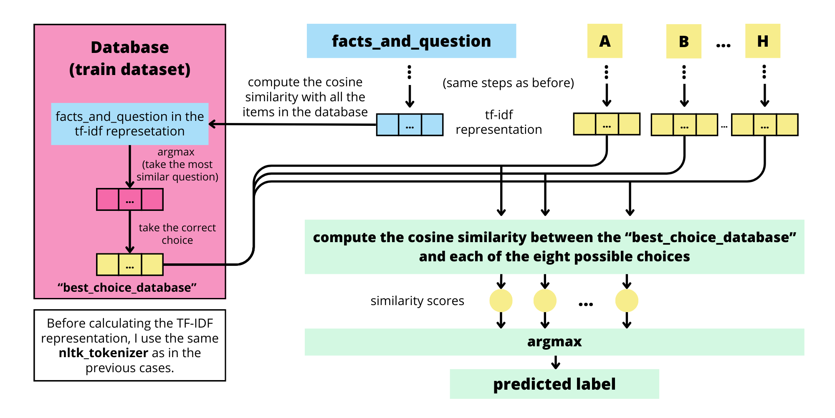
Take from the train set the item that is most similar to the one we are currently evaluating.

Slide 8
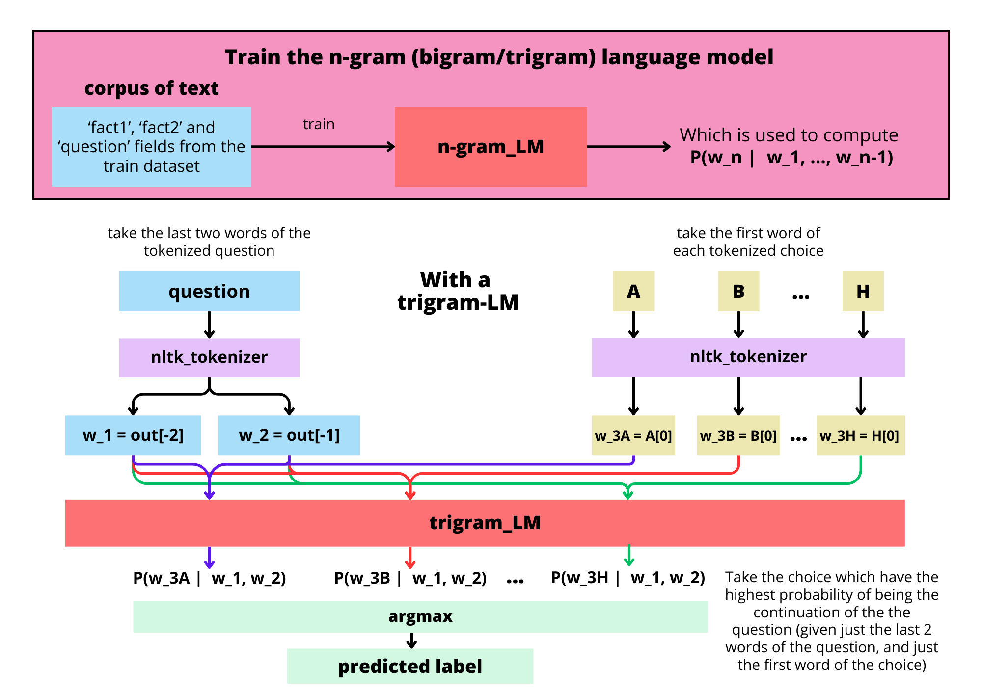
N-gram LM
What is the most likely continuation of the question, between the possible choices?

Slide 9
2. Word embeddings

Slide 10
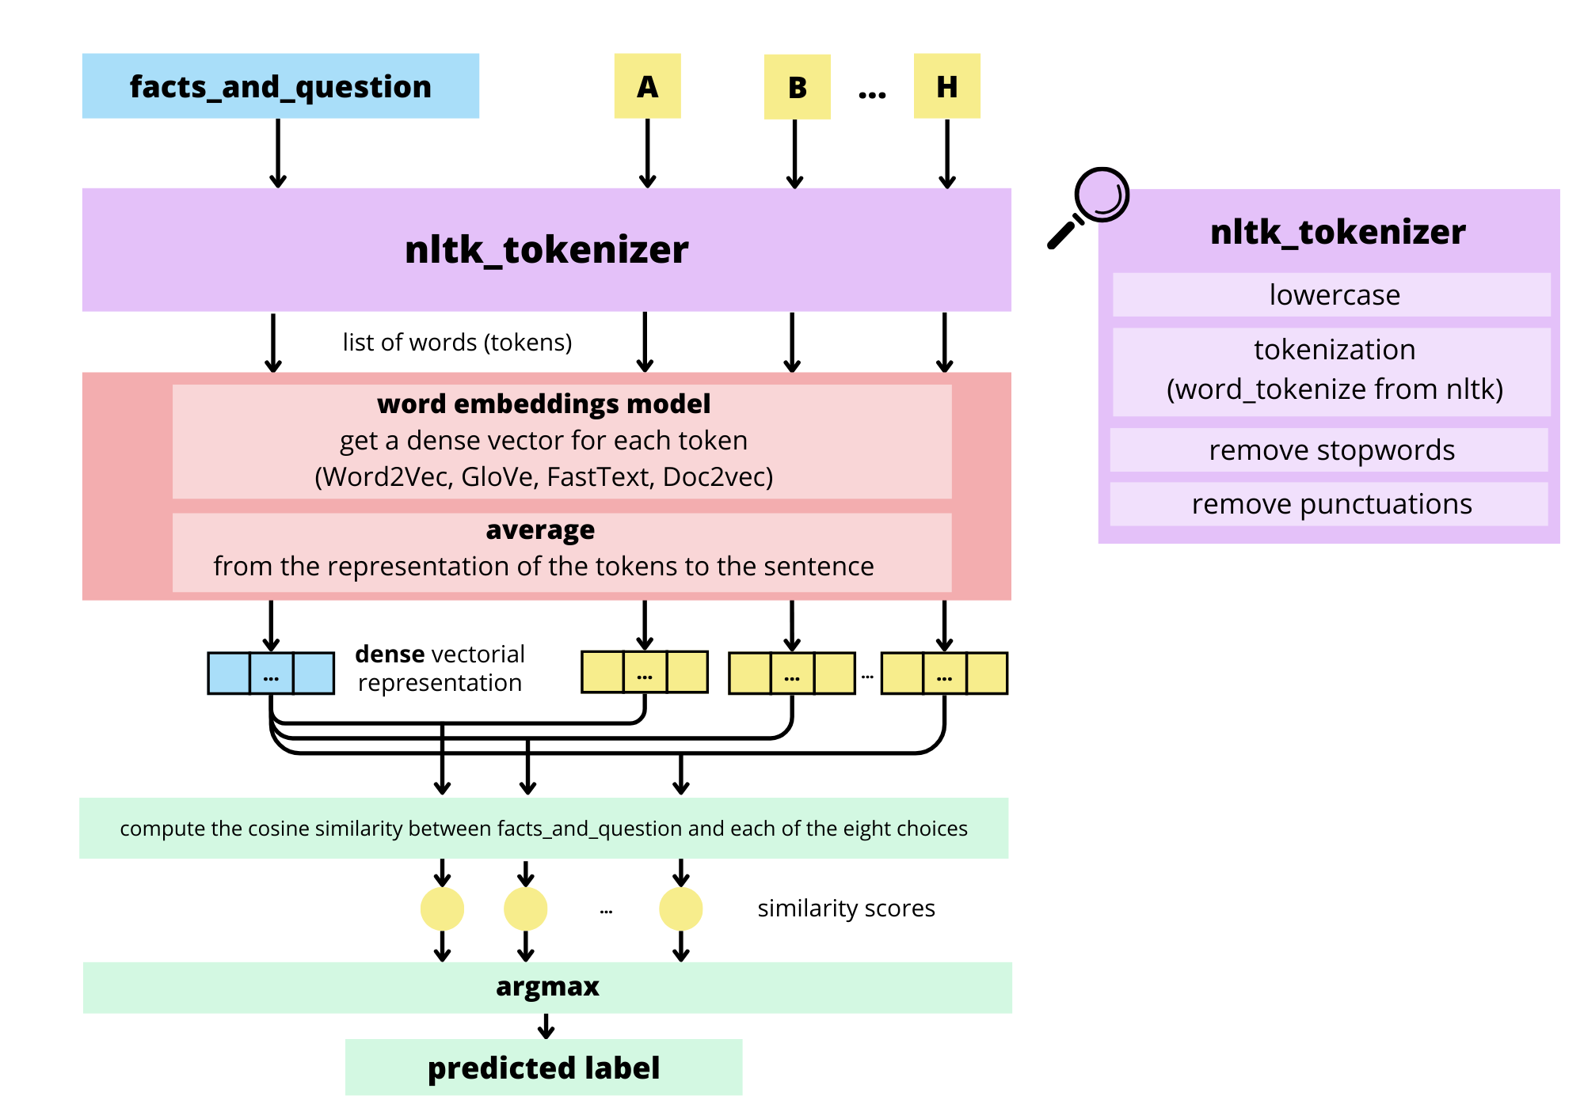
Static word embedding
We get the representation of a sentence from the average of the embeddings of the words in the sentence.
Variants:
Take the average after removing the duplicate words.
Take a weighted average, using the IDF score as the weight for each term.

Slide 11
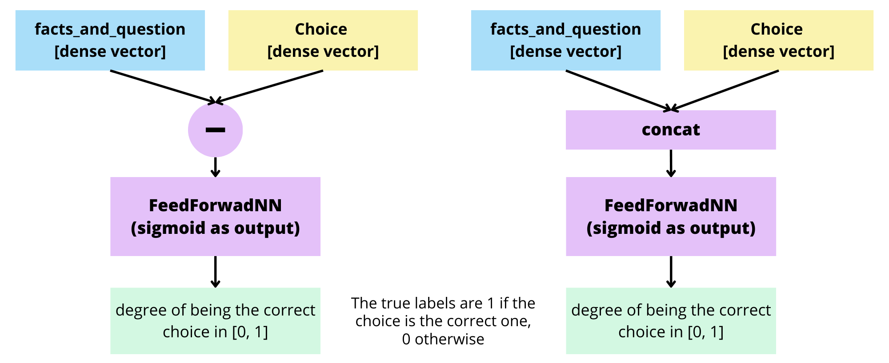
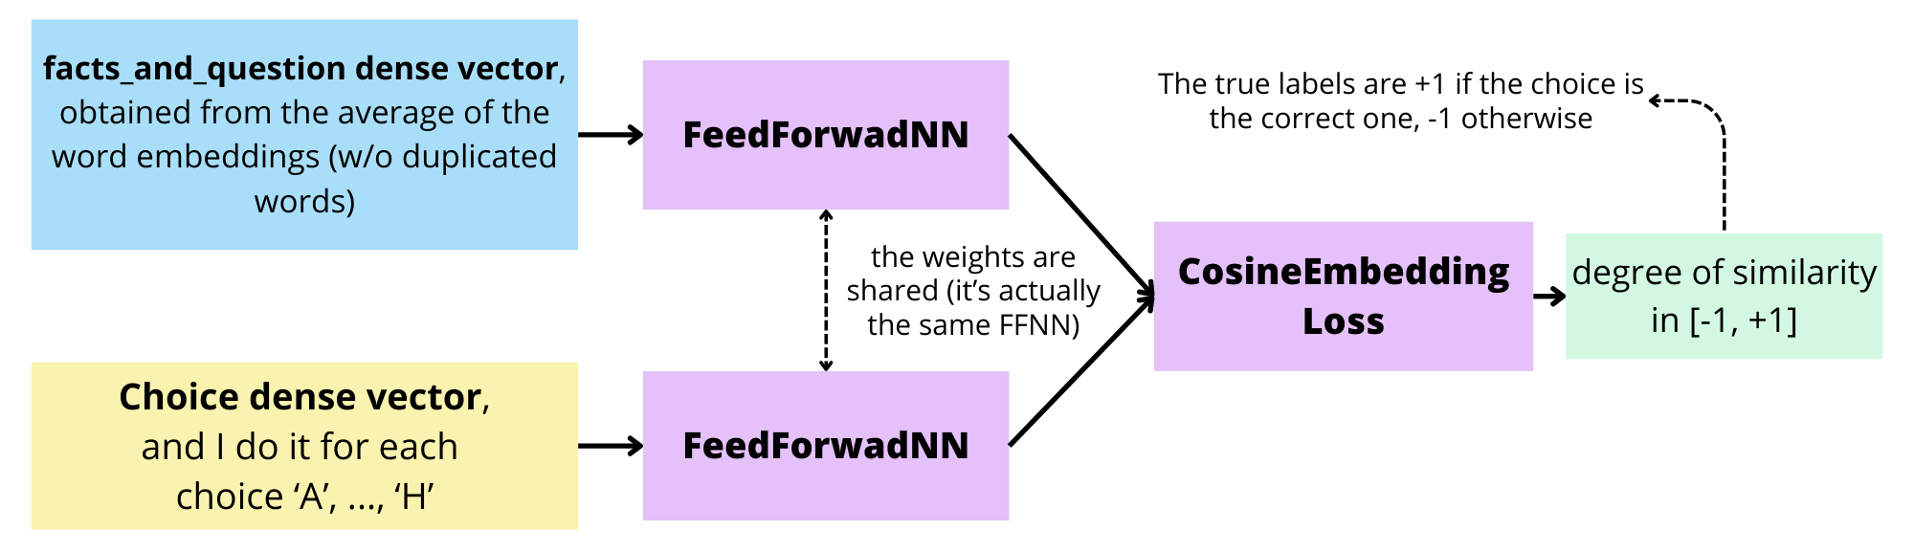
Alternatives to cosine similarity
I compare the question and the choices with a neural network, which is trained to make the question and the correct choice similar.
FeedForwardNN (difference or concatenation)
SiameseNN

Slide 12
3. BERT

Slide 13
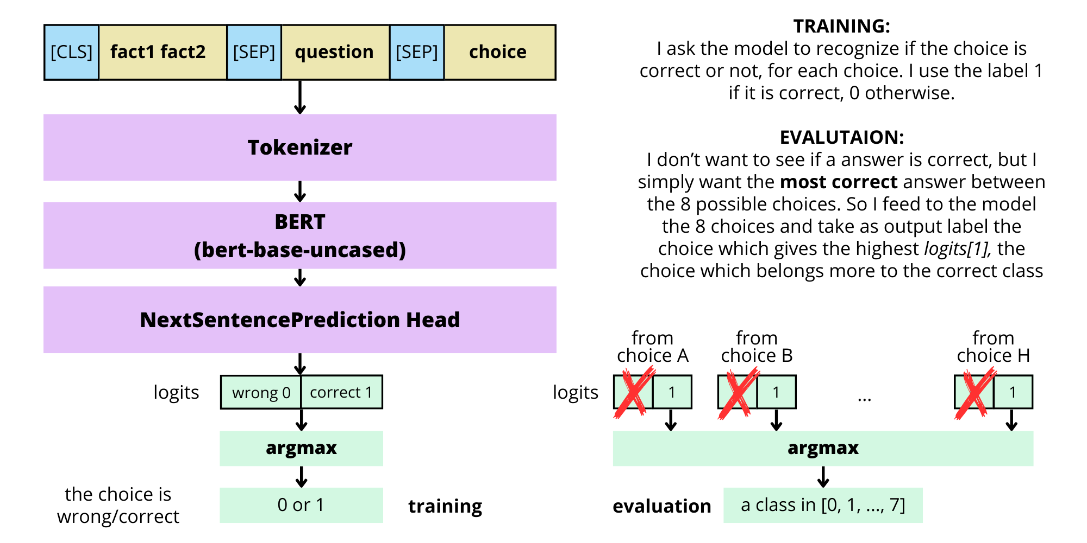
Binary classification
BERT trained for NextSentencePrediction.
For each item I have the following 8 inputs:
"[CLS] fact_1 fact_2 [SEP] question [SEP] choice_i [SEP]" for each choice i in ['A','B',…,'H’]
BERT: 'bert-base-uncased'

Slide 14
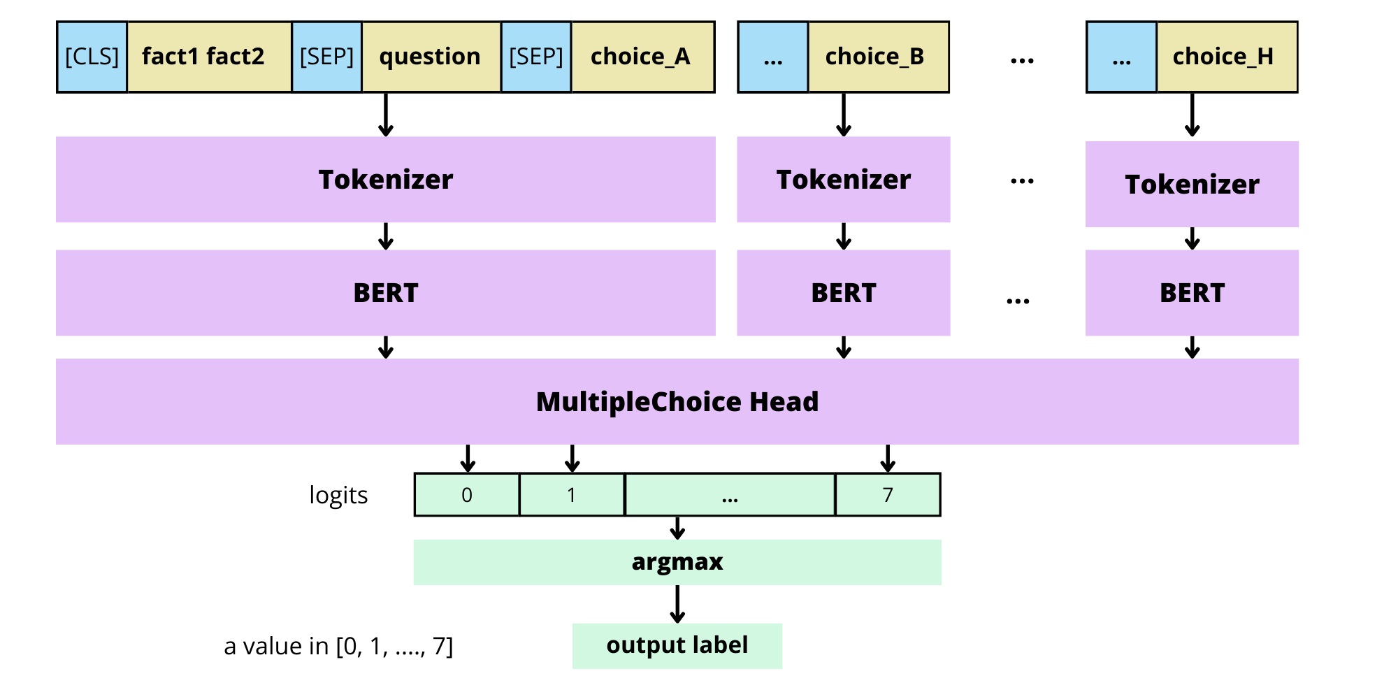
Multiclass classification
BERT trained for single-label multi-class classification.
Now I feed all the choices together to the model and I get one output logit for each of them.

Slide 15
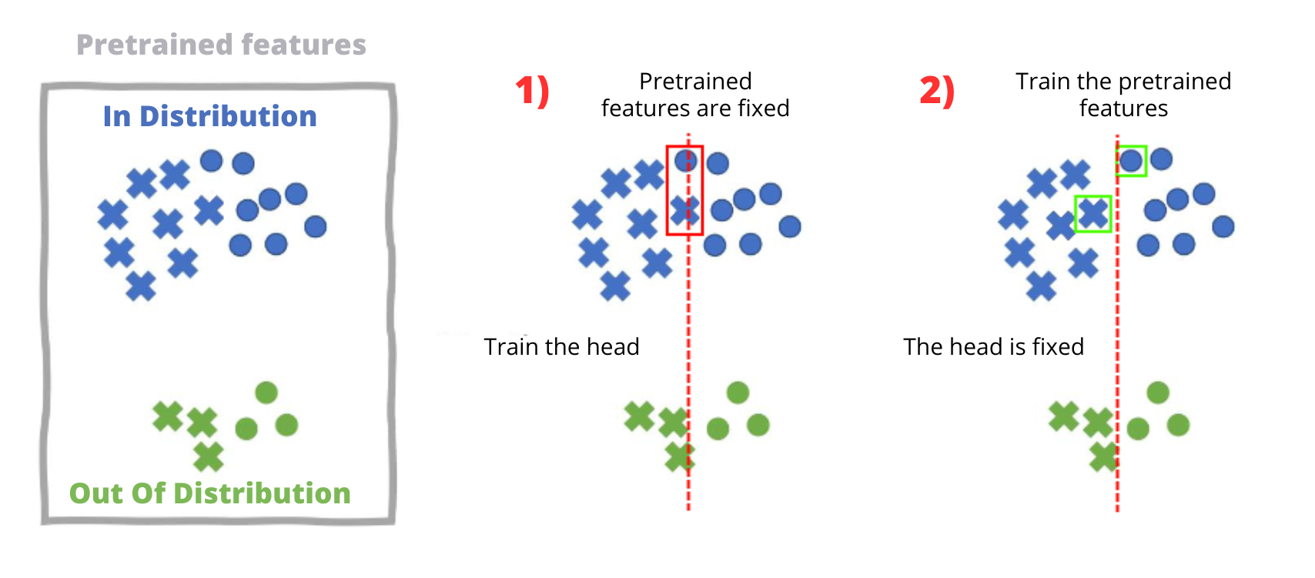
Training methods
fine-tuning
linear probing
combined method: after linear probing I train the pretrained features while the classifier is fixed

Slide 16
4. LLM Prompting

Slide 17
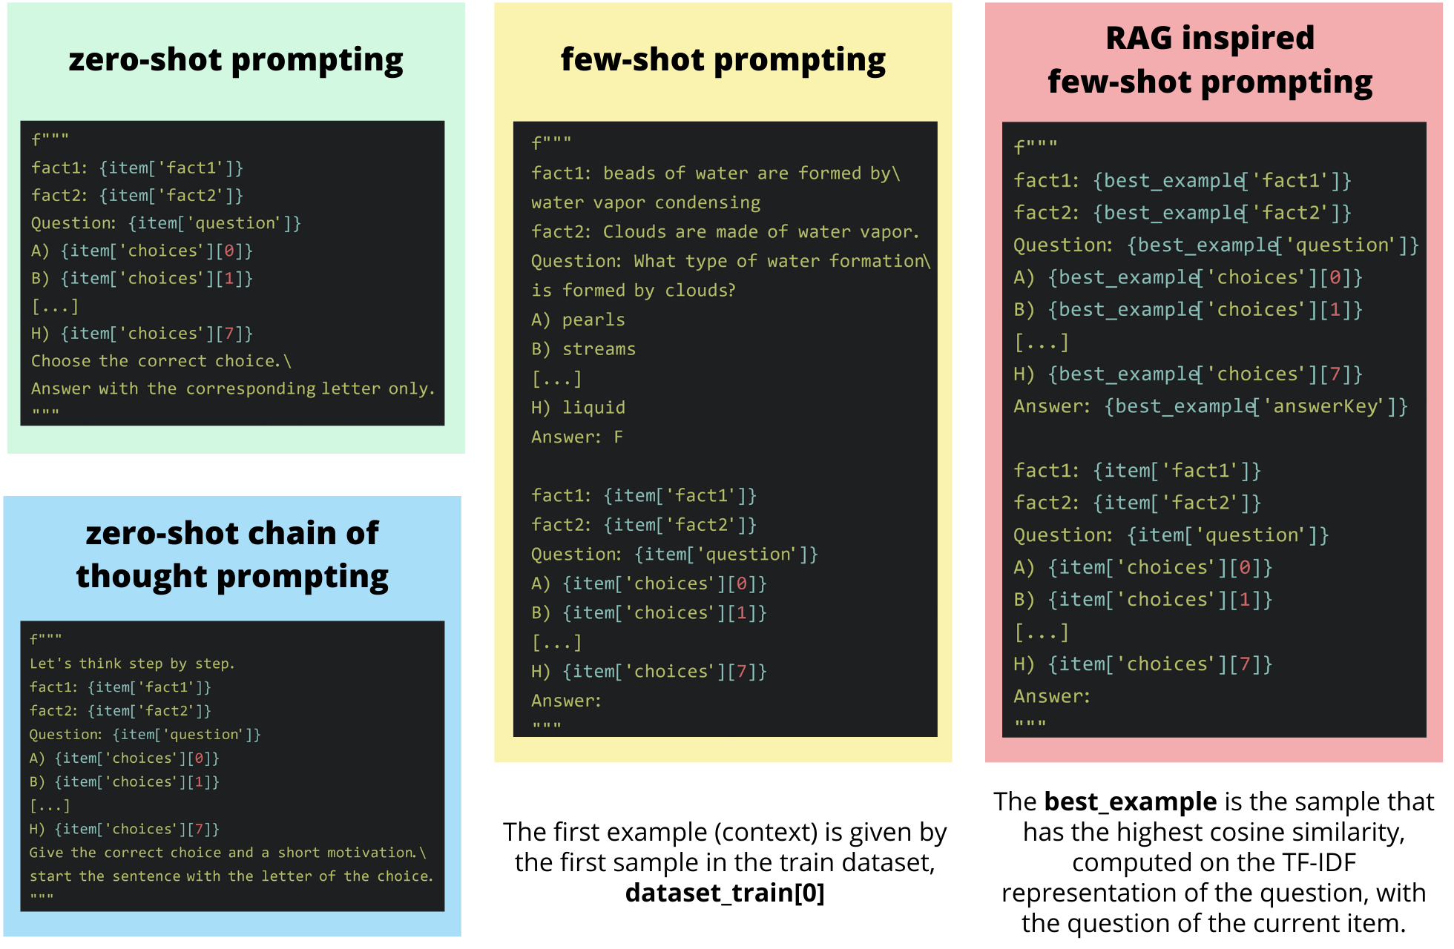
I just ask to a Large Language Model which is the correct answer. In the prompt I give the two facts, the question and the 8 possible choices. LLM: 'DeciLM-7B-instruct'

Slide 18
5. Evaluation on test set
 | Test accuracy (%) | Time elapsed (s) / n_samples
DeciLM – few-shot prompting | 99.03% | 2.23E-01
BERT – multiclass classification – combined method | 97.19% | 6.23E-03

Slide 19
Thanks for your attention!

